Slide 1




University of Basrah
Al-Zahraa Medical College
Ministry of higher Education and Scientific Research
Academic year 2021-2022
5th year
REPRODUCTIVE BLOCK
Lecture: 4
Duration : 1 hour
Pelvic Inflammatory Disease/STI
Presented by
Dr.RAYA MUSLIM AL HASSAN
Module staff:
Dr.Raya Muslim Al Hassan (Block leader)
Dr. Marwa Sadiq (co leader)
Dr.Abdalkareem Subber
Dr.Alla Hufthi
GYNAECOLOGY 20th
EDITION by Ten Teachers

Slide 2
Objectives
University of Basrah
Al-Zahraa Medical College
Ministry of higher Education and Scientific Research
To describe the microbiological criteria, clinical manifestations, diagnosis and treatment of herpes genitalis
To describe the microbiological criteria, clinical manifestations, diagnosis and treatment of genital warts
To describe the microbiological criteria, natural history and clinical manifestations, diagnosis and treatment of Syphilis
To describe the microbiological criteria, natural history and clinical manifestations, diagnosis and treatment of AIDS
To describe the microbiological criteria, clinical features, diagnosis of Chancroid, Granuloma inguinale , and Lymphogranuloma venereum

Slide 3
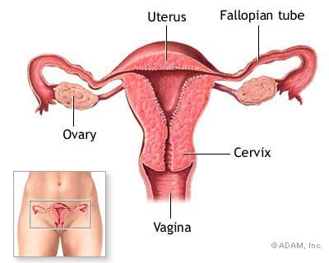
Pelvic Inflammatory Disease (PID)
University of Basrah
Al-Zahraa Medical College
Ministry of higher Education and Scientific Research
Pelvic Inflammatory Disease (PID) is an ascending infection from the endocervix causing:
Endometritis
Salpingitis
Oophoritis
Pelvic peritonitis
+/- tubo ovarian
abscess

Slide 4
Risk Factors ????
University of Basrah
Al-Zahraa Medical College
Ministry of higher Education and Scientific Research

Slide 5
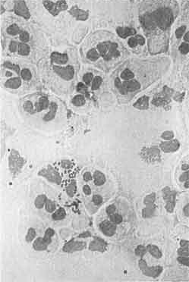
Causative Organisms
University of Basrah
Al-Zahraa Medical College
Ministry of higher Education and Scientific Research
Most cases are polymicrobial, the causative M.O. Of PID:
Nesseria Gonorrhoea
  Gram –‘ve intracellular diplococci
Chlamydia Trachomatis
  Gram –‘ve obligate intracellular M.O
Bacterial Vaginosis
  Anareobes, Enteric Gram –‘ve Bacteroides
Streptococci
Haemophillis Influenzae
Cytomegalovirus
Mycobacterium Tuberculosis
Notes:
1 & 2 are the most common pathogens.

Slide 6
Chlamydial infections
University of Basrah
Al-Zahraa Medical College
Ministry of higher Education and Scientific Research
Chlamydia Trachomatis is a Gram – ve
obligate intracellular bacterium.
The infective form is the elementary body, which develops within the host cell into the reticulate body. The reticulate body replicates eventually reverting back to elementary bodies, which leave the cell to infect other cells.

Slide 7
Clinical Presentations
University of Basrah
Al-Zahraa Medical College
Ministry of higher Education and Scientific Research
A - in Males :-
Urethritis
( Dysurea , urethral discharge, voiding difficulty )
My be associated with :-
Acute Epididymitis .
Reiters syndrome – Urethritis, conjunctivitis and arthritis are the classical triad of clinical manifestations associated with this syndrome. It predominantly
occurs in male patients.
Prostatitis.

Slide 8
B- in Females
University of Basrah
Al-Zahraa Medical College
Ministry of higher Education and Scientific Research
The majority of infections are asymptomatic , but it may be presented with :-
Mucopurulent discharge ( cervicitis ).
The acute urethral syndrome .
dysuria and frequency.
Pelvic Inflammatory Disease
Perihepatitis
Ocular infection

Slide 9
University of Basrah
Al-Zahraa Medical College
Ministry of higher Education and Scientific Research
C- Neonatal Infection
neonatal conjunctivitis (most common ).
neonatal pneumonia.

Slide 10
DIAGNOSIS
1. Antigen Detection
University of Basrah
Al-Zahraa Medical College
Ministry of higher Education and Scientific Research
( Immunofluorescence )
Specimens may be fixed to a slide & stained with a monoclonal antibody that is tagged with fluorescein. Slides are examined under an ultraviolet microscope.
Drawbacks
subject to observer
error time consuming .
One advantage is that the quality of the specimen in terms of cells can be assessed using this technique.

Slide 11
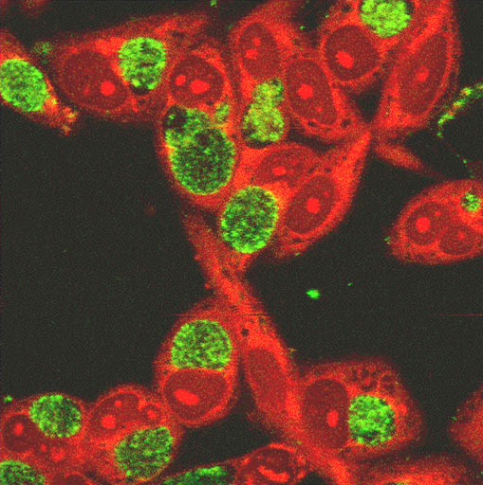
University of Basrah
Al-Zahraa Medical College
Ministry of higher Education and Scientific Research

Slide 12
2. Enzyme Immunoassays (EIA)
University of Basrah
Al-Zahraa Medical College
Ministry of higher Education and Scientific Research
.
Such tests allow large numbers of specimens to be processed with relative ease. Commercial tests are relatively cheap and vary in their sensitivity and specificity .
3. Molecular Methods (PCR, (polymerase chain reaction) Molecular methods offer high sensitivity and specificity, it is one of nucleic acid amplification test (NAAT test ) which identifies DNA of Chlamydia .

Slide 13
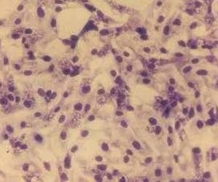
University of Basrah
Al-Zahraa Medical College
Ministry of higher Education and Scientific Research
4. Tissue culture
this is extremely expensive and could only be carried out in specialised laboratories. This has now been replaced by alternative methodologies

Slide 14
Specimen Collection
University of Basrah
Al-Zahraa Medical College
Ministry of higher Education and Scientific Research
Males – Urethral swab or first catch urine
Females – Endocervical swab.
– Urine ( less sensitive)
Neonates
Eye swab

Slide 15
Treatment
University of Basrah
Al-Zahraa Medical College
Ministry of higher Education and Scientific Research
Simultaneous treatment of current and recent sexual partners is required (contact tracing)
Abstain from sex during treatment .
Patients should also receive health education, advice on contraception and instruction in safe sex.
Retesting if any doubt about complete treatment, test of cure should be performed a minimum of 5 wks after initiation of treatment .

Slide 16
University of Basrah
Al-Zahraa Medical College
Ministry of higher Education and Scientific Research
Antibiotics treatment
The following treatment are effective for uncomplicated Chlamydia infection
Doxycycline 100mg twice/day for 7 days,
Azithromycin 1gm single dose is recommended in pregnancy,
ofloxacine 400 mg for 7 days,

Slide 17
Gonorrhea
University of Basrah
Al-Zahraa Medical College
Ministry of higher Education and Scientific Research
Neisseria Gonorrhoeae is a Gram – ve intracellular diplococcus.
It only grows in enriched media i.e. chocolate agar.

Slide 18
Clinical Presentation
A- in Females
University of Basrah
Al-Zahraa Medical College
Ministry of higher Education and Scientific Research
May be asymptomatic .
acute cervicitis .
urethral syndrome ( where the urethra is infected ).
PID: occasionally with tubo-ovarian abscess .
Bartholins abscess .
Disseminated gonococcal infection: a rare complication that affects women more than men. The common symptoms are pain on the joints, tenosynovitis and rash.

Slide 19
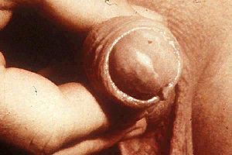
B - in Males
University of Basrah
Al-Zahraa Medical College
Ministry of higher Education and Scientific Research
Gonococal urethritis
Incubation period 2-7 days
Abrupt onset of severe dysuria
Purulent urethral discharge
Most urethral infections are symptomatic.
prostatitis, proctitis, pharyngitis
Epididymitis
Disseminated gonoccocal infection

Slide 20
University of Basrah
Al-Zahraa Medical College
Ministry of higher Education and Scientific Research
Diagnosis
Neisseria gonorrhoeae is a fragile organism and specimens should be taken and plated directly on to media at the bedside.
Specimen collection
Females – Endocervical swab, urethral swab, rectal and pharyngeal swab
Males – Urethral, rectal and pharyngeal swabs

Slide 21
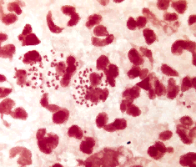
1- Gram Stain for GC
University of Basrah
Al-Zahraa Medical College
Ministry of higher Education and Scientific Research

Slide 22

2- CULTURE & SENSITIVITY is more sensitive than microscopy
University of Basrah
Al-Zahraa Medical College
Ministry of higher Education and Scientific Research

Slide 23
Treatment
University of Basrah
Al-Zahraa Medical College
Ministry of higher Education and Scientific Research
Simultaneous treatment of current and recent sexual partners is required.
Abstain from sex during treatment .
Patients should also receive health education, advice on contraception and instruction in safe sex.
cephalosporins is the mainstay of treatment

Slide 24
University of Basrah
Al-Zahraa Medical College
Ministry of higher Education and Scientific Research
are effective against sensitive strains of gonorrhea
Ceftriaxone250mg single dose IM
Cefixim400mg single dose oral
Spectinomycin2 g as a single dose IM
Azithromycin 1g single dose
Amoxycillin1g+probencid2g as single dose
Ciprofloxacine500mg or Ofloxacin 400 mg as a single dose

Slide 25
Pathogenesis
Pathogenesis
University of Basrah
Al-Zahraa Medical College
Ministry of higher Education and Scientific Research
Infection of the cervix (endocervicitis) spreads, either directly or via lymphatics to the endometrium, uterine tubes and the pelvic peritoneum.
Peritonitis
Salpingitis/ oophoritis/ tubo-ovarian abscess
Endometritis
Cervicitis

Slide 26
Clinical criteria
Diagnosis
University of Basrah
Al-Zahraa Medical College
Ministry of higher Education and Scientific Research
Abdominal, pelvic pain & dyspareunia
Temperature >38°C
Abnormal cervical mucopurulent discharge.
Heavy/inter-menstrual bleeding
Adenexal, pelvic tenderness &/or cervical motion tenderness (cervical excitation).
Pelvic mass

Slide 27
Classification
Clinical Manifestations
University of Basrah
Al-Zahraa Medical College
Ministry of higher Education and Scientific Research
Overt
40%

Slide 28
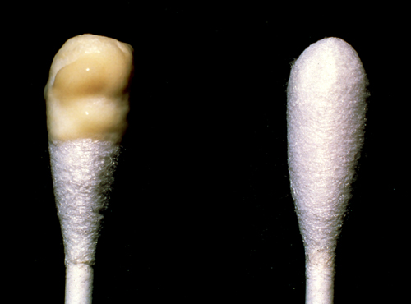
Mucopurulent Cervical Discharge
(Positive swab test)
Diagnosis
University of Basrah
Al-Zahraa Medical College
Ministry of higher Education and Scientific Research
Source:Seattle STD/HIV Prevention Training Center at the University
of Washington/ Claire E. Stevens and Ronald E. Roddy

Slide 29
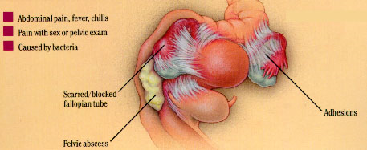
Sequelae of PID
University of Basrah
Al-Zahraa Medical College
Ministry of higher Education and Scientific Research
Immediate
  Tubo-ovarian abscess
  Pyo-salpinx
Long Term
  Ectopic Pregnancy
  Tubal infertility
  Dyspareunia (Painful
  sexual intercourse)
  Chronic PID / Chronic pelvic pain
  Pelvic adhesions

Slide 30
Chronic Pelvic Inflammatory Disease
University of Basrah
Al-Zahraa Medical College
Ministry of higher Education and Scientific Research
Symptoms > 6 Months Duration
Pelvic pain
Secondary dysmenorrhoea
Deep dyspareunia
Menstrual disturbance
Recurrent acute painful exacerbations

Slide 31
Diagnosis
A- Laboratory Investigations of PID
University of Basrah
Al-Zahraa Medical College
Ministry of higher Education and Scientific Research
Pregnancy test
Triple and urethral swabs
  High vaginal swab – Bacteria vaginosis organisms
  Endocervical swab – Neisseria gonorrhoea
  Endocervical swab - Chlamydia trachomatis
  Urethral swab – Chlamydia trachomatis (males only)
Midstream Urine
  Leucocytes and nitrates
C-Reactive Protein and ESR
  Markers for acute infection / inflammation
The presence of leucocytes on vaginal wet preparation.

Slide 32
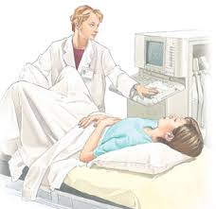

B - Other investigations
Diagnosis
University of Basrah
Al-Zahraa Medical College
Ministry of higher Education and Scientific Research
1. Transvaginal sonography or MRI.
for pelvic mass

Slide 33
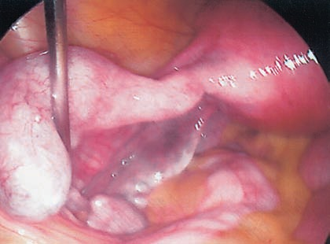
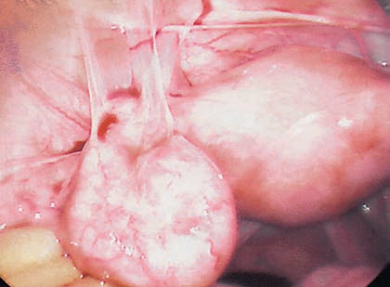
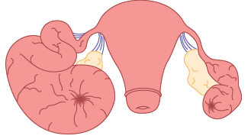
2. Laparoscopy
University of Basrah
Al-Zahraa Medical College
Ministry of higher Education and Scientific Research
a. Left tubal hydrosalpinx
c. Peritubal adhesions
b. Bilateral hydrosalpinx

Slide 34
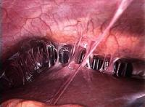
Perihepatic adehesions (Fitz-Hugh-Curtis syndrome)
University of Basrah
Al-Zahraa Medical College
Ministry of higher Education and Scientific Research

Slide 35
Differential Diagnosis
University of Basrah
Al-Zahraa Medical College
Ministry of higher Education and Scientific Research
Ectopic pregnancy
Acute appendicitis
Irritable Bowel Syndrome (IBS)
Ovarian cyst accidents (torsion, rupture, haemorrhage)
Urinary Tract Infection (UTI)
Functional pelvic pain of unknown origin

Slide 36
Treatment
Management
University of Basrah
Al-Zahraa Medical College
Ministry of higher Education and Scientific Research
Regimens must provide coverage of N. gonorrhoeae, C. trachomatis, anaerobes, Gram-negative bacteria, and streptococci.
( A combination of ceftriaxone, doxicycline & metronidazole)
Treatment should be instituted as early as possible to prevent long term sequelae.
In the patient with a pelvic abscess, surgery is warranted. For drainage of abscess+/-salpingo-oopherectomy.

Slide 37
GENITAL HERPES
University of Basrah
Al-Zahraa Medical College
Ministry of higher Education and Scientific Research
It is a chronic lifelong viral infection with the potential for rare to frequent recurrences, herpes simplex virus (HSV), establishes latent genital infection in the sacral dorsal root ganglia.
Microbiology
HSV has two serotypes, HSV-1 and HSV-2.
HSV-1 is most commonly associated with oral lesions (cold
sores), but about 50% of primary genital herpes is due to HSV-1.
HSV-2 is the cause of 50% of primary genital herpes and 95% of recurrent genital herpes.
The frequency of recurrences is much higher after a primary infection with HSV-2 than HSV-1.
Primary genital herpes infection occurs when the infected person has no HSV-2 or HSV-1 antibodies.

Slide 38
University of Basrah
Al-Zahraa Medical College
Ministry of higher Education and Scientific Research
Clinical presentation
multiple, bilateral, and painful anogenital vesicles
or ulcers with an erythematous base,
Retention of urine.
Systemic symptoms may also be present,
such as fever, headache,malaise, and lymphadenopathy.
Acute cervicitis may be present.
The lesions heal without scarring
in 14 to 21 days.
Recurrent genital herpes infection
Occurs when the infected person has HSV antibodies to the same serotype.
The lesions are fewer, unilateral, and less painful.
Systemic symptoms and lymphadenopathy are rare.

Slide 39
University of Basrah
Al-Zahraa Medical College
Ministry of higher Education and Scientific Research
Diagnosis
viral culture that requires live cells from a lesion, which is expensive, time-consuming, and has relatively low sensitivity
PCR, which is expensive and very accurate, is very useful for testing cerebrospinal fluid, but is not used routinely on genital lesions
type-specific serologic tests for HSV-1 and HSV-2 antibodies. These are highly sensitive and specific tests that can identify infected individuals who are asymptomatic

Slide 40
University of Basrah
Al-Zahraa Medical College
Ministry of higher Education and Scientific Research
Treatment
The goals of treatment
symptom relief Analgesics and local anaesthetic gels , relief of acute urine retention by urinary catheterization
acceleration of lesion healing
decrease in frequency of recurrences.
Education and supportive counseling
antiviral agents (acyclovir, famciclovir, and valacyclovir) are safe and effective for treating primary and episodic outbreaks and for providing suppressive therapy for patients with chronic disease.
No treatment can eradicate the latent virus from the dorsal ganglia of the spinal cord.
Work is underway to develop an HSV vaccine.

Slide 41
HUMAN PAPILLOMA VIRUs (HPV)
University of Basrah
Al-Zahraa Medical College
Ministry of higher Education and Scientific Research
Microbiology
Genital HPV is a common viral STI, There are about 200 HPV subtypes, HPV 6 and 11 are associated with genital warts, HPV 16 and 18 linked to cervical cancer.
Clinical presentation
latent infections (Most HPV cases )with no visible lesions and are only diagnosed by DNA hybridization testing performed in the evaluation of an abnormal Pap smear.
Subclinical infections have lesions that are only visible during colposcopy.
Clinical infections are characterized by readily visible “warty” growths called condylomata acuminate
on the vulva, vagina, cervix, urethra, and perianal
area.

Slide 42
University of Basrah
Al-Zahraa Medical College
Ministry of higher Education and Scientific Research
Transmission of HPV can occur even when there are no visible lesions.
Regular condom use may provide some degree of protection. During pregnancy, condylomata may increase in number and size, but transmission from mother to infant is rare.
Treatment
Goals of treatment
to relieve symptoms (pain and bleeding)
to ameliorate psychological and cosmetic
concerns of the patient.

Slide 43
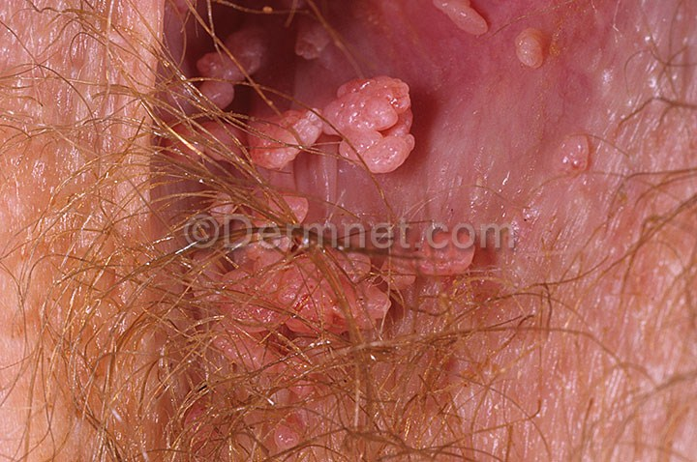
University of Basrah
Al-Zahraa Medical College
Ministry of higher Education and Scientific Research
Multiple therapeutic modalities are available, and all are comparable
Provider-applied topical therapies include
podophyllin resin 10% to 25% in tincture of benzoin
trichloroacetic acid (TCA) or bichloracetic acid (BCA) 80% to 90%.
Patient-applied topical therapies include
(1) podofilox 0.5% solution or gel
(2) imiquimod 5% cream.
Surgical therapies include
(1) cryotherapy
(2) surgical excision
(3) electrocautery
(4) laser vaporization
(5) intralesional interferon.
Podophyllin, podofilox, and imiquimod
should not be used during pregnancy.

Slide 44


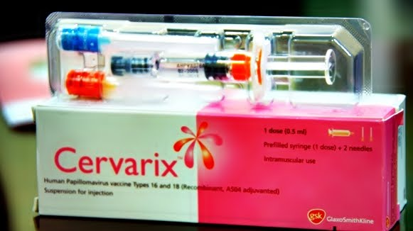
University of Basrah
Al-Zahraa Medical College
Ministry of higher Education and Scientific Research
An HPV-like particle vaccine
(Gardasil) is now available
that protects against four
HPV serotypes (6, 11, 16, and
18), which together are
responsible for 70% of
cervical cancers and 90%
of genital warts. This vaccine
Was used in females aged 9
to 26 years.
Another vaccine against
HPV types 16 and
18 only (Cervarix) .

Slide 45
Syphilis
University of Basrah
Al-Zahraa Medical College
Ministry of higher Education and Scientific Research
Microbiology
Syphilis is caused by the spirochete bacterium, Treponema pallidum.
Natural history of untreated syphilis
It enters the body through breaks in the skin of the external genitalia that occur during sexual intercourse.
Once the spirochete has entered, the untreated disease progresses through four consecutive stages: primary, secondary, latent and tertiary syphilis.
Antibiotic treatment at any stage can prevent the late, life-threatening sequelae of the disease.
Syphilis may also be transmitted from a woman to her fetus at any point during pregnancy, with serious consequences.

Slide 46
University of Basrah
Al-Zahraa Medical College
Ministry of higher Education and Scientific Research
The primary lesion of syphilis, the chancre, develops in locations close to where T. pallidum typically enters the body: Chancre is a painless, small papule that persist for 1–2 months and heal spontaneously.
The secondary syphilis is a disseminated form.
Bloodborne spirochetes populate the dermis throughout the body causing a widespread papular rash over the trunk and extremities. Because the disease is systemic, fever, myalgias, lymphadenopathy, sore throat and headache are common. Secondary syphilis can also be associated with immune complex deposition in the joints, kidneys and eyes, leading to arthritis, glomerulonephritis, nephrotic syndrome and uveitis. Untreated secondary syphilis resolves over 4–12 weeks, leaving the patient symptom free.
latent period
The subsequent months to years until the onset of
symptoms of tertiary syphilis is known as the latent
period.

Slide 47
University of Basrah
Al-Zahraa Medical College
Ministry of higher Education and Scientific Research
Tertiary syphilis
usually appears many years after the disseminated stage. Tertiary syphilis can involve multiple organs, including the cardiovascular and nervous systems.
Complications of syphilis in pregnancy include miscarriage, stillbirth, premature delivery and congenital syphilis which carry neonatal mortality rate 50%, may present during late childhood with stigmata of congenital syphilis, including 8th nerve deafness, interstitial keratitis and abnormal teeth. The effect of late congenital syphilis are not prevented unless the mother is treated before 20 wk gestation

Slide 48
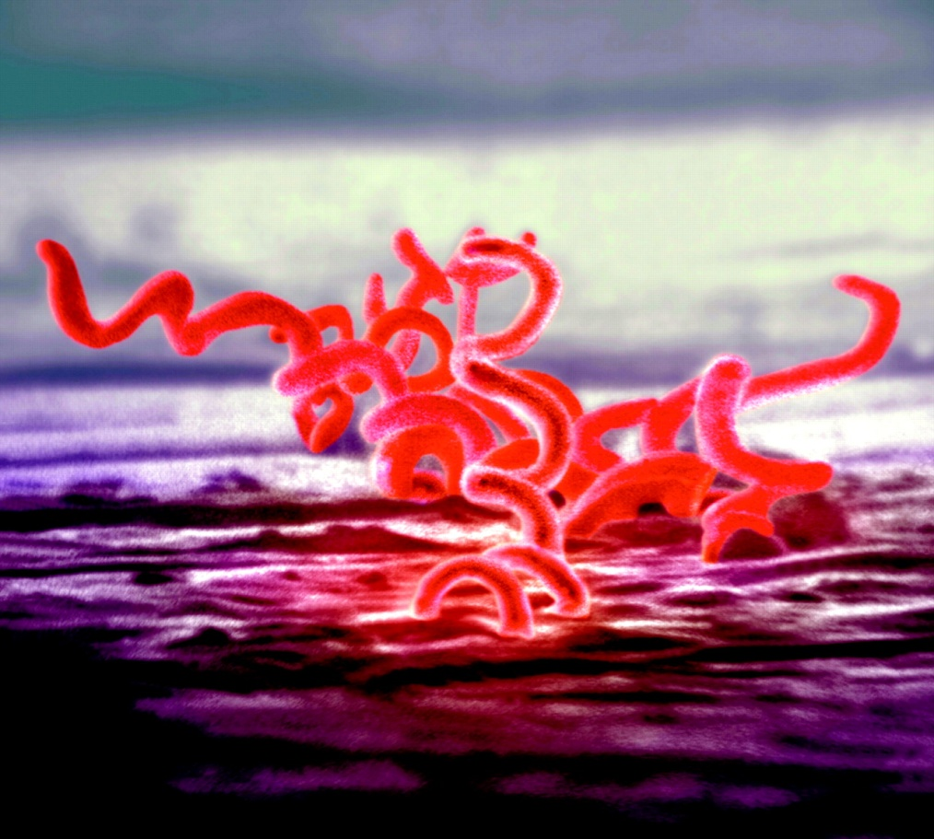
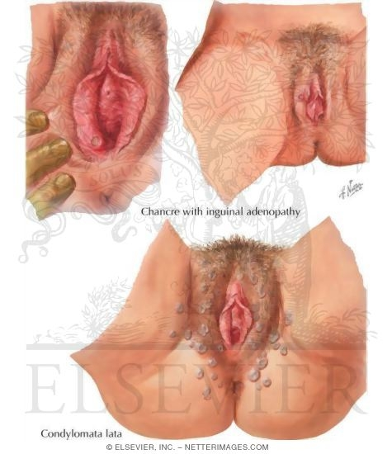
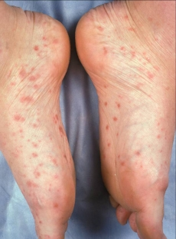
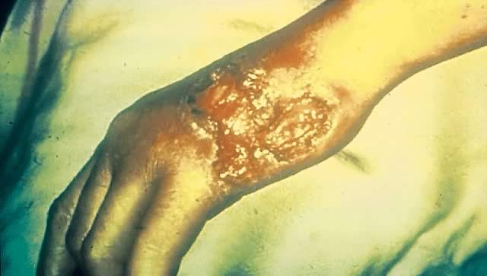
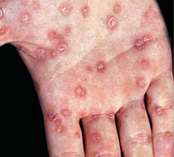
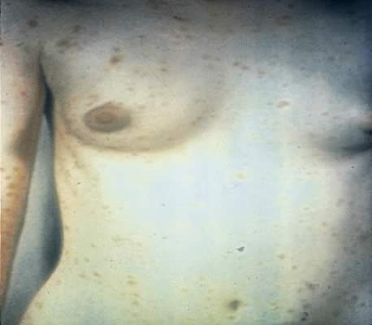
Treponema pallidum
chancre
Tertiary syphilis
Secondary syphilisis

Slide 49
University of Basrah
Al-Zahraa Medical College
Ministry of higher Education and Scientific Research
Diagnosis :
1-demonstrating the microorganism by dark-field microscopy. Spirochaetes can be revealed by silver stain.
2-non specific test such as venereal diseases research laboratories(VDRL)and rapid plasma reagin (RPR) test.
3-serological test for syphilis including fluorescent treponemal antibody(FTA) test(most sensitive and specific test for syphilis, but time consuming to perform/ require skilled interpretation)
Treponema pallidum haemagglutination assay(TPHA), treponema pallidum particle agglutination test-routine specific treponema test.
4- In doubtful cervical chancre lesion can be biopsied.
In secondary syphilis VDRL positive , dark ground examination can be performed from mucosal lesions or condylomata lata, VDRL titre should fall twofold every 3 months, becoming negative within 2 years.

Slide 50
University of Basrah
Al-Zahraa Medical College
Ministry of higher Education and Scientific Research
treatment
Penicillin mainstay of treatment
Procaine penicillin 1.2 MU daily i.m. 12 days
Benzathine penicillin 2.4 MU i.m. repeated after 7 days
Doxycyclin100 mg two times a day for 14 days

Slide 51
HIV infection
University of Basrah
Al-Zahraa Medical College
Ministry of higher Education and Scientific Research
Microbiology
HIV is a retrovirus. Its genetic material is carried as RNA wrapped in a viral protein coating. The viral surface expresses a receptor called gp120 that binds specifically to receptors on lymphoid cells
Transmission:
Viral transmission occurs through direct contact with bodily fluids, most often semen or blood.
Viral spread can occur via sexual contact (heterosexual) (, via parenteral exposure (intravenous drug abuse and transfusions) or perinatal transmission.

Slide 52
University of Basrah
Al-Zahraa Medical College
Ministry of higher Education and Scientific Research
Natural history and principles of treatment:
Symptoms of primary infection often persist for 2–3 weeks before resolving spontaneously.
The disease then enters an asymptomatic phase. This can last from several months to many years. The length of this symptom-free phase appears to depend on the pathogenicity of the infecting viral strain.
Coinfection with other viruses or other sexually transmitted disease (STD) pathogens may speed disease progression.
During the asymptomatic phase, viral replication continues within infected lymphoid cells (mainly CD4+ T cells).
Infected immune cells are destroyed by the virus and, eventually, the host becomes immunocompromised.

Slide 53
University of Basrah
Al-Zahraa Medical College
Ministry of higher Education and Scientific Research
In this immunocompromised state, the HIV-infected individual is vulnerable to a variety of opportunistic viral, bacterial, fungal and parasitic infections. Opportunistic pathogens such as Pneumocystis carinii, Cryptosporidium and Cryptococcus .
Patients who are severely immunocompromised are also at risk for the development of certain neoplasms, including Kaposi sarcoma, human papillom a virus-related cervical cancers and some lymphomas. The development of opportunistic infections or neoplasms in a patient infected with HIV defines the acute immunodeficiency syndrome (AIDS).

Slide 54
University of Basrah
Al-Zahraa Medical College
Ministry of higher Education and Scientific Research
Diagnosis of HIV& monitoring:
By finding antibodies to gp 120,(outer membrane protein binds to CD4 receptor)
During seroconversion p24 antigen (p24 is a viral protein surround the RNA and enzymes present within the core of the virus) is detectable in the serum before antibodies are produced.
Normal lymphocyte CD4 level in peripheral blood is 0.5% , the risk of AIDS developing within 1 year if CD4 level drop to<0.2%.

Slide 55
University of Basrah
Al-Zahraa Medical College
Ministry of higher Education and Scientific Research
Gynecological manifestations:
HPV infection flourishes, genital warts often persist despite aggressive surgical treatment.
Chronic HPV infection can result in cervical carcinoma, vulval intraepithelial neoplasia, most physician perform cervical cytology annually in women with HIV
Postpartum endometritis is commoner in this group of women.
Eruption of secondary HSV may become wide spread, severe and persist for weeks if not diagnosed and treated.
HIV-infected women are urged to use condom to prevent them transmitting the infection and are adviced to use more reliable form of contraception antiretroviral agents may interfere with the metabolism of synthetic oestrogens.
.

Slide 56
University of Basrah
Al-Zahraa Medical College
Ministry of higher Education and Scientific Research
Chancroid
is caused by Haemophilus ducreyi. The lesions, called soft chancres, are painful and are usually
accompanied by pelvic adenopathy. Diagnosis is made clinically and confirmed with cultures. Treatment
is with azithromycin, 1 g orally in a single dose, or ceftriaxone 250 mg intramuscularly in a single dose.
Granuloma inguinale (donovanosis)
is caused by Calymmatobacterium granulomatis. The lesions are red and raised. Treatment is with doxycycline, 100 mg twice a day for a minimum of 3 weeks.

Slide 57
University of Basrah
Al-Zahraa Medical College
Ministry of higher Education and Scientific Research
Lymphogranuloma venereum
is caused by C. trachomatis. Vesicles progress to bubo formation. A complement fixation test is available for diagnosis. Treatment is with doxycycline, 100 mg twice a day for at least 3 weeks.

Slide 58
Thank you

